Slide 1
Techniques in Programming MIT121

Slide 2
Week 1
Introduction to
subject IDLE, coding styles, variable naming, commenting

Slide 3
This Lecture
Introduction
Course Details
Assessment Information
Computer processing
Python, IDLE
Coding styles, variable naming, commenting
Summary
Notes:
IDLE stands for Integrated Development and Learning Environment

Slide 4
Course Details
Three-hour class contact: 1-hour lecture and 2-hour tutorial.
Resources:
See the references in the subject outline.
Check CANVAS for other resources.

Slide 5
Student Learning Outcomes
a | Deconstruct processes, and develop algorithms and data structures to address given technical problems
b | Perform unit testing of self-authored and provided program code
C | Develop code using an IDE and format code using appropriate style, etiquette and commenting
d | Design and develop well-structured programs using procedural programming
e | Design and develop well-structured programs using fundamental event-driven programming
Notes:
IDE (Integrated Development Environment): An IDE is a software application that provides comprehensive facilities to programmers for software development. It typically includes a code editor, debugger, compiler or interpreter, and other tools needed for software development.
Procedural Programming: Procedural programming is a programming paradigm that follows a linear and top-down approach to solving a problem. It is based on procedures or routines, which are sets of instructions or tasks that are executed in a sequential manner.
Event-Driven Programming: Event-driven programming is a programming paradigm where the flow of the program is determined by events such as user actions, sensor outputs, or messages from other programs or processes.

Slide 6
Assessment Details
Assessment 1: Individual Assignment
Due date: | Week 6
Weighting: | 20%
Length and Format: | Word, program code
Assessment Details: | Given a detailed process, students develop an algorithm and select appropriate data structures to represent the process logically. Given a correct algorithm, develop a working program.
Assessment addresses SLOs | SLO A: Deconstruct processes, and develop algorithms and data structures to address given technical problems SLO C: Develop code using an IDE and format code using appropriate style, etiquette and commenting
Marking Criteria | Please refer to Marking Rubric on Canvas
Notes:
SLO stands for Student Learning Outcome

Slide 7
Assessment Details
Assessment 2: Individual Assignment
Due date: | Week 13
Weighting: | 40%
Length and Format: | Word, program code
Assessment Details: | Given a problem featuring a client-facing graphical user interface (GUI), students must: 1. Develop a GUI featuring event-driven hooks, and, 2. Develop and document working procedural code to execute functions
Assessment addresses SLOs | SLO B: Perform unit testing of self-authored and provided program code SLO D: Design and develop well-structured programs using procedural programming SLO E: Design and develop well-structured programs using fundamental event-driven programming
Marking Criteria | Please refer to Marking Rubric on Canvas

Slide 8
Assessment Details
Assessment 3: Final Exam
Due date: | During the exam week
Weighting: | 40%
Length and Format: | 2-hour invigilated written exam
Assessment Details: | Laboratory examination comprising practical and theoretical elements. Summative assessment of the course. This will be 2 hours closed book exam and will consist of fill-in the program code, short answers and essay questions. Students will need to demonstrate the ability to design and develop a program by creating flowcharts, and pseudocode and writing some code for a given problem. Students will also be examined on their understanding of the theory
Assessment addresses SLOs | SLO A: Deconstruct processes, and develop algorithms and data structures to address given technical problems SLO B: Perform unit testing of self-authored and provided program code SLO C: Develop code using an IDE and format code using appropriate style, etiquette and commenting
Marking Criteria | Please refer to Marking Rubric on Canvas

Slide 9
How to pass?
Students MUST achieve a mark of at least 40% in the final exam (or final assessment item if no exam), AND at least a mark of 50% in total, to pass this subject.

Slide 10
Avoid Plagiarism
Working with other students is a very good method of learning and is strongly encouraged.
BUT at assignment time, written answers (especially code) must not be shared – sharing ideas is OK.
Proper acknowledgement of all non-staff assistance with an assignment avoids plagiarism

Slide 11
Computer
A Machine for executing computer programs
Two parts
Hardware
Software
Computer programs

Slide 12
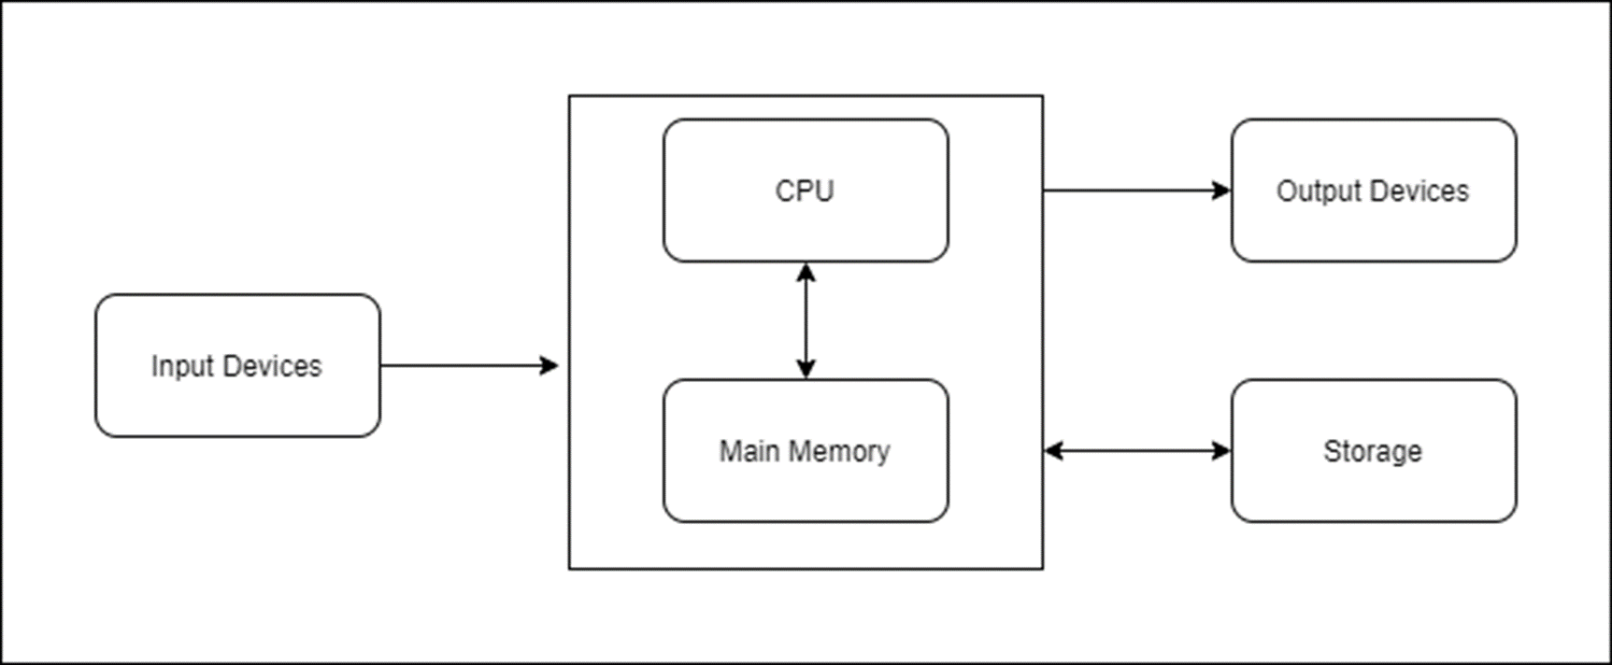
Functional view of a computer
Notes:
Input Devices:
Function: Input devices are used to enter data and instructions into the computer system. Examples include keyboards, mice, scanners, and microphones.
Connection: Data from input devices is sent to the main memory (RAM) of the computer.
Main Memory (RAM):
Function: Main memory, or Random Access Memory (RAM), temporarily stores data and instructions that the CPU needs while performing tasks. it loses its contents when the computer is turned off.
Connection: It communicates directly with the CPU, providing it with the necessary data and instructions.
CPU (Central Processing Unit):
Function: The CPU is the brain of the computer, responsible for executing instructions and processing data. It performs arithmetic and logical operations and controls the operation of other components.
Connection: The CPU retrieves data and instructions from the main memory, processes them, and sends the results back to the main memory or to output devices and storage.
Output Devices:
Function: Output devices display or present the results of the computer's processing. Examples include monitors, printers, speakers, and projectors.
Connection: The CPU sends processed data to the output devices to be presented to the user.
Storage:
Function: Storage devices are used to store data and instructions permanently or for long-term use. Examples include hard drives, SSDs, and external storage devices.
Connection: Data from the storage can be transferred to the main memory for processing, and processed data can be saved back to storage for future use.

Slide 13
Hardware components
include devices that perform:
Input
Processing
Data storage
Output
Notes:
Input:
Keyboard and Mouse: Used for general computer interaction, such as typing documents and navigating the operating system.
Scanner: Used to digitize physical documents for electronic storage and editing.
Microphone: Used for voice commands, recording audio, or participating in video calls.
Webcam: Used for video conferencing or recording video.
Processing:
CPU: Executes instructions from software applications and the operating system.
GPU: Renders images, videos, and animations. Essential for gaming, video editing, and other graphics-intensive tasks.
RAM: Temporarily stores data that is being actively used or processed by the CPU. For example, when editing a document or browsing the web.
Data Storage:
HDD: Stores the operating system, applications, and user data such as documents, photos, and videos.
SSD: Provides faster access to data and is often used for the operating system and frequently used applications to improve performance.
USB Flash Drive: Used for transferring files between computers or as a backup storage device.
Output:
Monitor: Displays the graphical user interface and visual feedback from software applications.
Printer: Produces physical copies of digital documents, such as reports, photos, or forms.
Speakers: Output audio from media files, system sounds, or communication applications like VoIP.
Projector: Used in presentations to display visual output to a larger audience.

Slide 14
Input Devices
Magnetic Stripe Cards
Chip Cards
Smart Cards
Contactless Payment Cards
Point-of-Sale (POS) Devices
Automated Teller Machine (ATM) Devices
Bar-Code Scanners
Radio Frequency Identification (RFID) Devices
Pen Input Devices
Touch Screens

Slide 15
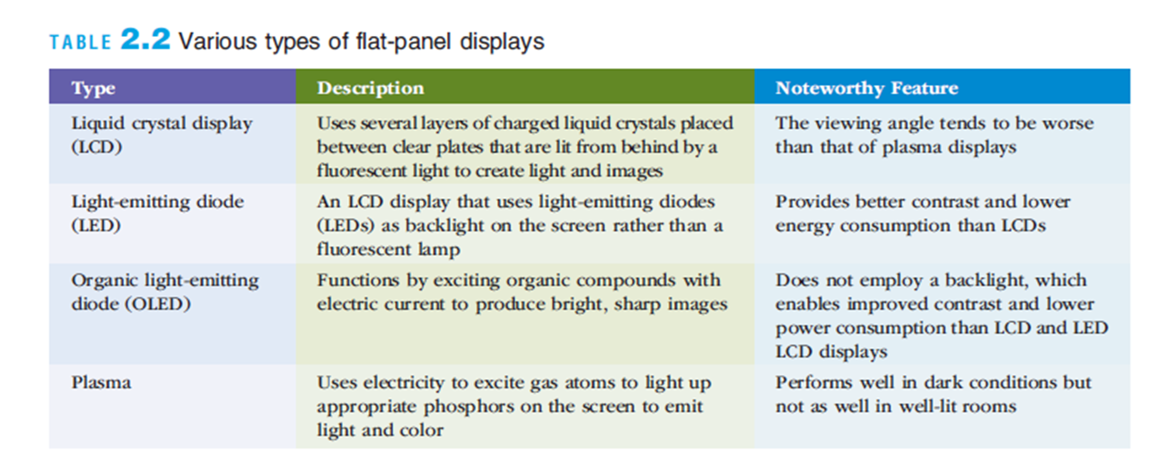
Output Devices
Display Screens
Used to show output from the computer

Slide 16
Software
Consists of computer programs that control the workings of computer hardware
Software can be divided into two types:
System software – includes operating system (OS), utilities, and middleware that coordinate the activities and functions of the hardware and other programs
Application software – programs that help users solve computing problems
Notes:
Operating Systems (OS):
Windows
Linux:
Utilities:
Antivirus Software:
Middleware:
Database Middleware: Oracle Database Middleware, Microsoft SQL Server, which facilitate communication between databases and applications.
Web Servers: Apache HTTP Server, Nginx, which serve web pages and handle web requests.

Slide 17
System Software
Coordinate the activities and functions of the hardware and other programs
Supports the application programs’ problem-solving capabilities
Types of systems software
Operating systems
Utility programs
Middleware

Slide 18
Application Software
Application programs’ primary function
To apply the power of the computer to enable people, workgroups, and the entire enterprise to solve problems and perform specific tasks
Many software options are available
Software can be selected that best meets the needs of the individual, workgroup, or enterprise

Slide 19
Programming
A computer program is a detailed step-by-step instruction set that tells the computer what to do.
Word
PowerPoint
Excel
Programming languages
Will help you write those instruction sets.
C, C++, C#, JAVA, Python etc.

Slide 20
What is Python?
high-level, general-purpose programming language. Its design focuses on readability with significant indentation.
supports multiple programming paradigms
e.g. structured, object-oriented and functional programming
Notes:
indentation is used to define the structure of the code, such as loops, conditionals, and functions.

Slide 21
Why Python?
Simple syntax
Highly interactive
Easy to learn and use
Extensive libraries of high-level resources
Completely portable, free, and open source
Widespread user (programmer) community
Graphical user interfaces
Internet scripting
Component integration
Database programming

Slide 22
Add two numbers in Python
a = int(input("enter first number: "))
b = int(input("enter second number: "))
sum = a + b print("sum:", sum)

Slide 23
How computer run this program
Converting high level languages into machine code and then executing them can be done in two ways.
Compilers
Interpreters
Notes:
Compilers:
Definition:
A compiler is a program that translates the entire high-level source code of a program into machine code before the program is run. The resulting machine code is stored in an executable file.
Process:
Compilation: The compiler reads the entire source code, checks it for errors, and translates it into machine code.
Linking: The compiler links together various code modules and libraries, resolving references and creating a final executable file.
Execution: The resulting executable file can be run directly by the computer’s operating system.
Interpreters:
Definition:
An interpreter directly executes the high-level source code line-by-line or statement-by-statement without converting it into machine code beforehand.
Process:
Interpretation: The interpreter reads a statement from the source code, translates it to an intermediate form (sometimes directly to machine code), and immediately executes it.
Execution: This process repeats for each statement in the source code until the program is complete.

Slide 24
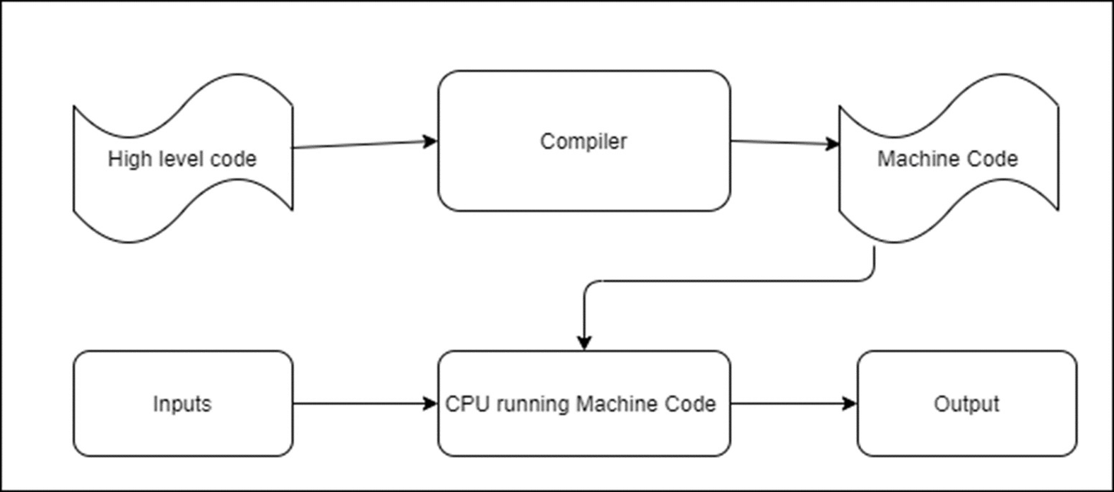
Compiler

Slide 25
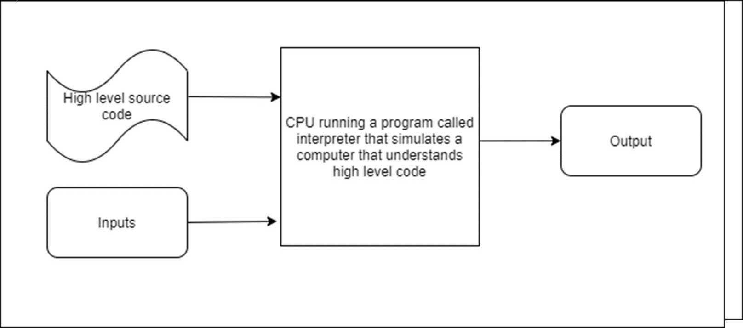
Interpreter

Slide 26
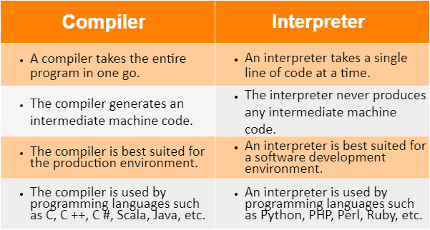
Compiler Vs Interpreter
Notes:
A compiler is a program that translates the entire source code written in a high-level programming language into machine code or an intermediate code.
An interpreter is a program that reads the source code line by line and executes it directly without generating a separate executable file.

Slide 27
Python
Python is a high-level programming language.
Visit http://www.python.org
The latest version (3.13.0).
Comes with the IDLE (Integrated Development and Learning Environment)
In this class, we will use EduLab (a virtual environment) which has IDLE.

Slide 28
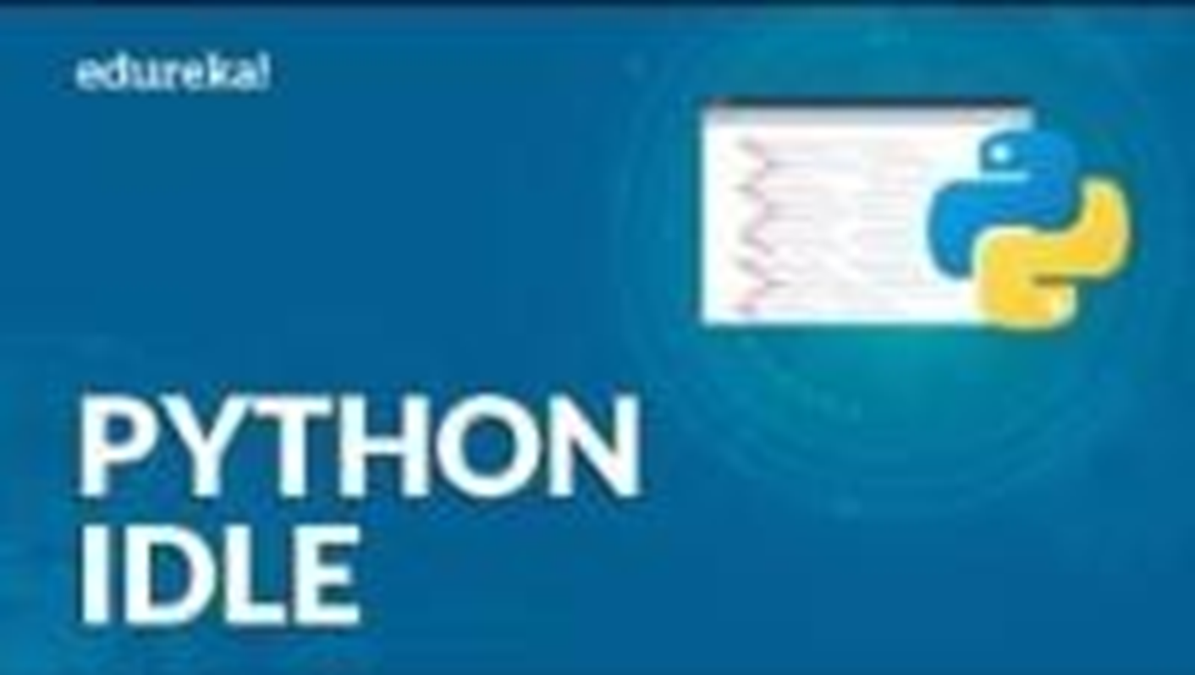
IDLE
Notes:
Python IDLE (Integrated Development and Learning Environment) is an integrated development environment for Python. when you install Python on your computer, IDLE provides an interactive Python shell where you can enter Python commands and see the results immediately

Slide 29
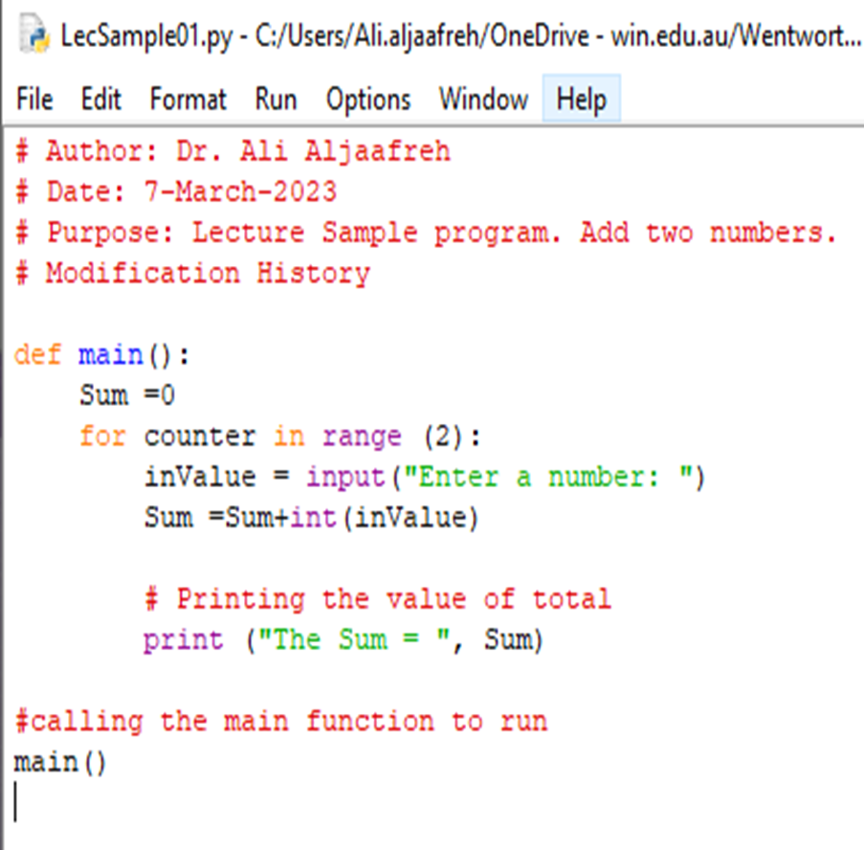
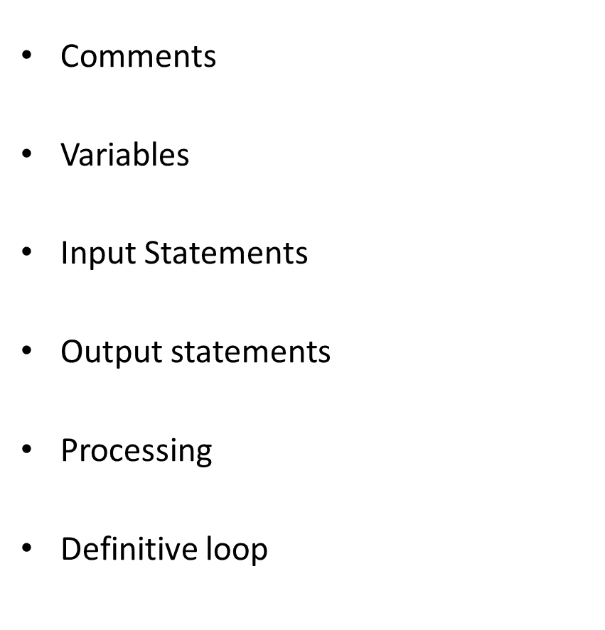
IDLE

Slide 30

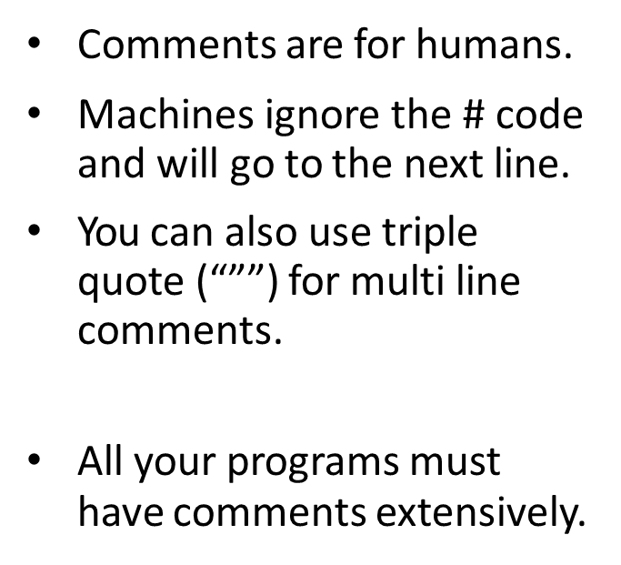
Comments
Notes:
def is a keyword used to define a function. A function is a reusable block of code that performs a specific task. Defining functions helps to organize code, make it more readable, and enable code reuse.

Slide 31
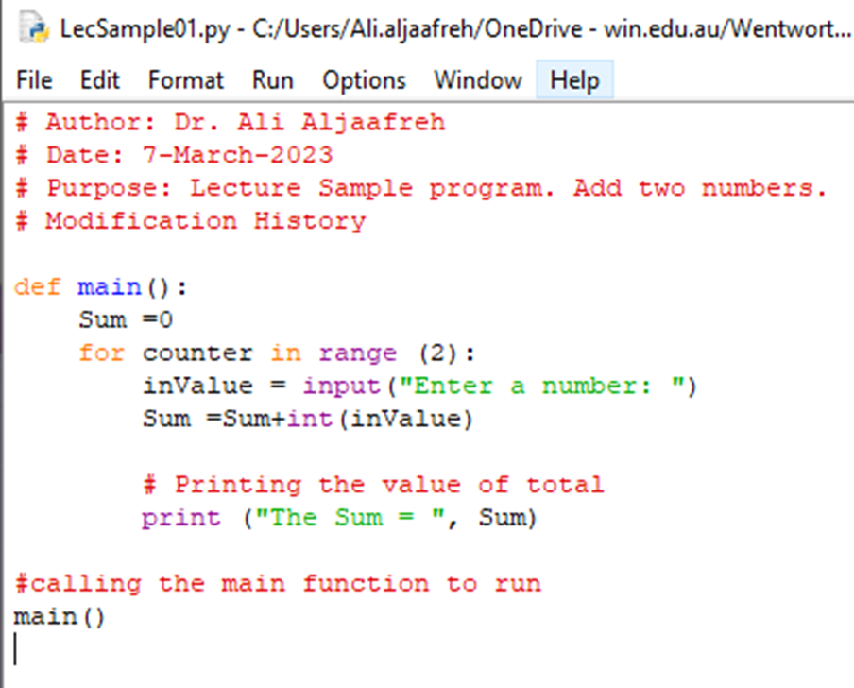
Variables
Variables are used to remember some values.
3 Variables in this program:
sum
counter
inValue
Notes:
In Python, a variable is a symbolic name that is used to reference or store a value.
Python automatically determines the type of the variable based on the value assigned to it.
Variables can be reassigned to different types of values. For example, a variable that initially holds an integer can later be reassigned to a string.
Variable names can contain letters, numbers, and underscores (_).
Variable names must start with a letter or an underscore.
Variable names are case-sensitive (e.g., myVar and myvar are different).

Slide 32
Naming Variables
There are rules to follow when naming your variables.
Variable names can contain letters, numbers, and the underscore.
Variable names cannot contain spaces.
Variable names cannot start with a number.
Case matters—for instance, temp and Temp are different.
Notes:
Case matters
Eg:a1 is different from A1

Slide 33
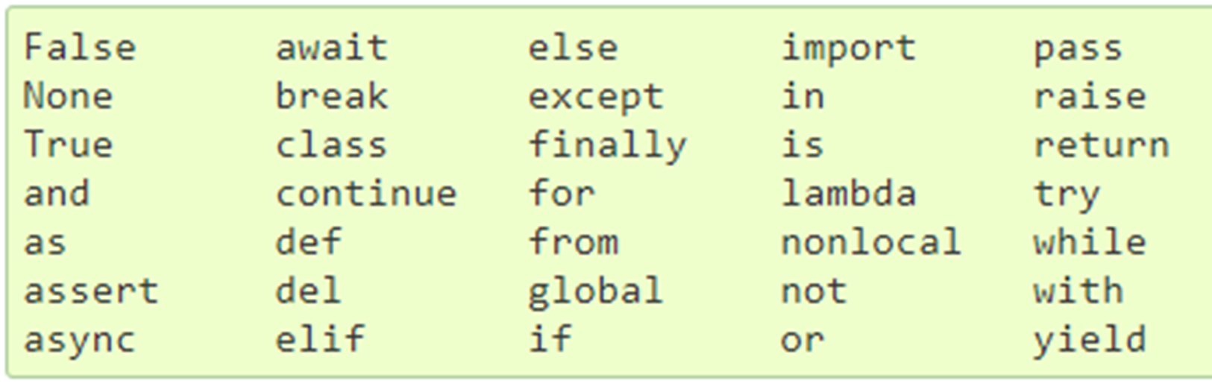
Reserved Words (Keywords)
The following words are the keywords in Python, meaning they have a specific purpose in the system. So, they cannot be used as Variables.

Slide 34

Input Statements
Input
<variable> = input(<prompt>)
Reads the input and assigns the value to the variable.
Only “Text” type is read using “Input” statement.

Slide 35

Output Statements
Print is the output statement.
Print()
Print(<Expr>)
Print(<Expr> <Expr>)

Slide 36

Processing
This program
Create a variable sum and
initialize it to “0”
For counter is 0 and 1 (run twice)
Read a number
Add to sum
Print sum

Slide 37
Arithmetic Operators
+, -, *, /, **, %, abs()
+ addition
- subtraction
* multiplication
/ division
** exponentiation
abs() absolute value

Slide 38
Assignment statements
Simple assignment
<variable> = <expr>
Assign input
<variable> = input(<prompt>)
Simultaneous Assignment
<variable>, <variable>, <variable> = <expr>, <expr> , <expr>
Notes:
Simple assignment in Python involves assigning a value to a variable using the = operator
<variable> is the name of the variable.<expr> is the expression or value being assigned to the variable
Assigning input involves using the input() function to take user input and assign it to a variable.
<prompt> is the message displayed to the user.
The input() function always returns a string. If you need the input to be of another type, you have to convert it.
Simultaneous assignment, also known as multiple assignment, allows you to assign values to multiple variables in a single statement.

Slide 39
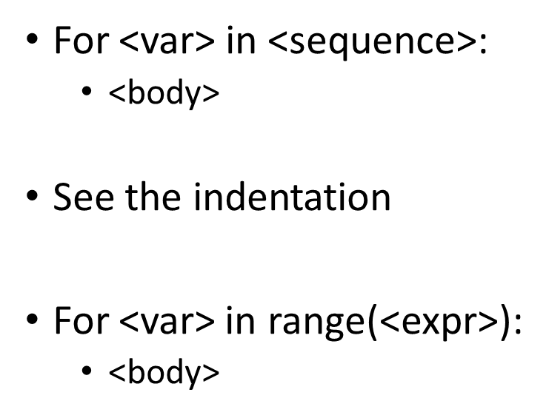
Definitive Loop
Notes:
Indentation refers to the practice of adding spaces or tabs at the beginning of lines of code to visually indicate the structure and nesting of blocks. In many programming languages, including Python, indentation is not just for visual aesthetics but is a significant part of the syntax and determines the scope or grouping of code.

Slide 40
Summary
Python High level programming language.
Compiled or interpreted
Reading input
Writing output
Variables
Processing
Arithmetic operations
Definite loop
Keywords (reserved words)

Slide 41
Next Session Lecture
Assignment, Arithmetic, Input statements

